Slide 1


Network Layer - 2
SE3331-1 (2025 Fall)
IPADS, Shanghai Jiao Tong University
https://www.sjtu.edu.cn
Credits to Katrina LaCurts, MIT

Slide 2
Review: OSI, TCP/IP & Protocol Stack
7th Application Layer
Application Layer
HTTP
SMTP
POP3
FTP
…
End-to-end Layer
6th Presentation Layer
5th Session Layer
4th Transport Layer
Transport Layer
TCP
UDP
3th Network Layer
Network Layer
IP
Network Layer
ICMP
2nd Link Layer
Link Layer
ARP & RARP
Ethernet
PPP
…
Link Layer
1st Physical Layer
WiFi
Fiber
TD-LTE
FDD
…
OSI
TCP/IP
CSE

Slide 3
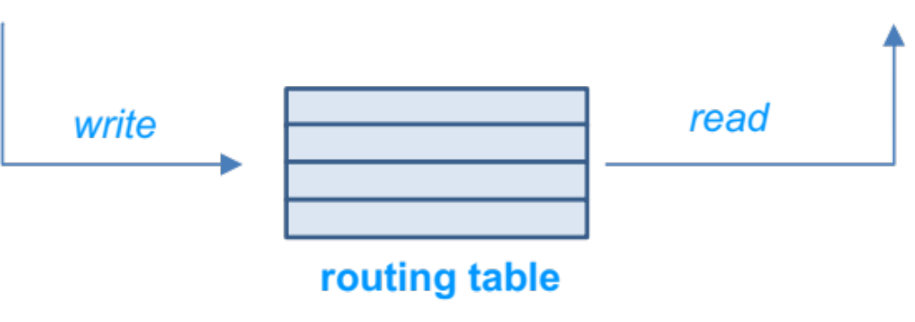
Review: Control-plane VS. Data-plane
Control-plane
  Control the data flow by defining rules
  E.g., the routing algorithm
Data-plane
  Copies data according to the rules
  Performance critical
  E.g., the IP forwarding process

Slide 4
Review: Routing Protocols
Feature | Interior Gateway Protocol (IGP) | Exterior Gateway Protocol (EGP)
Scope | Inside an Autonomous System (AS) | Between Autonomous Systems (AS)
Primary Goal | Find the best path; fast convergence | Apply routing policies; control path propagation
Typical Protocols | OSPF, IS-IS, RIP, EIGRP | BGP (the only one currently used)
Focus / Concern | Speed, efficiency, network topology | Policy, reachability, AS path
Scale | Manages hundreds to thousands of routes | Manages the global internet (hundreds of thousands of routes)

Slide 5
Case Study: BGP
Border Gateway Protocol

Slide 6
Policy Routing
Regions also want to implement their own policies
  Switches make routing decisions based on some policies set by a human
  Routing protocol must disseminate enough info to enable those policies
What policies are typical in BGP?
  Regions don't want to send traffic on a path unless they have financial incentive to do so
  Mechanism of enforcement: selective advertisements
    Region-1 won't tell region-2 about a path unless it will make money by letting region-2 use the path
    Each region will have a different view of the network, and that view will (almost certainly) not contain every physical link

Slide 7
Typical BGP Relationships
Customer/provider
  Customers pay for access (transit), which the provider provides
Peers
  Peers provide mutual access to a subset of each's routing tables
    The subset that contains their transit customers
  Why peer? Can save money and improve performance
  Why not peer? You'd rather have customers

Slide 8
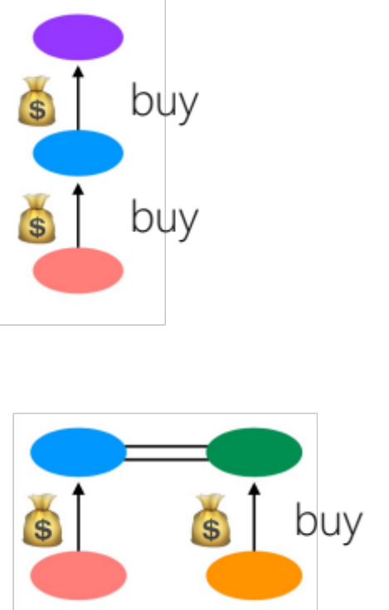
Customers and Peers
Customer/Provider ("transit")
  Customer pays provider for transit
Peers
  Peers allow (free) mutual access to each other's customers

Slide 9
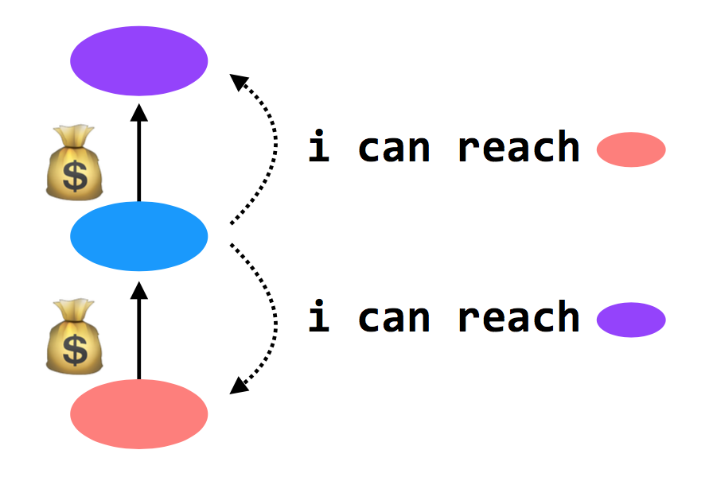
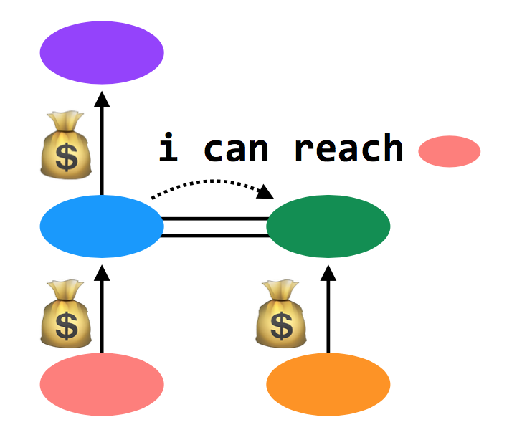
Customers and Peers
Customer/Provider ("transit")
  Providers tell everyone about themselves
  their customers, and tell their customers
  about everyone
Peers
  Peers tell each other about their customers

Slide 10
Import Policies
Customer > peer > provider
  And then a variety of other attributes when this rule isn't sufficient
Goal: make money

Slide 11
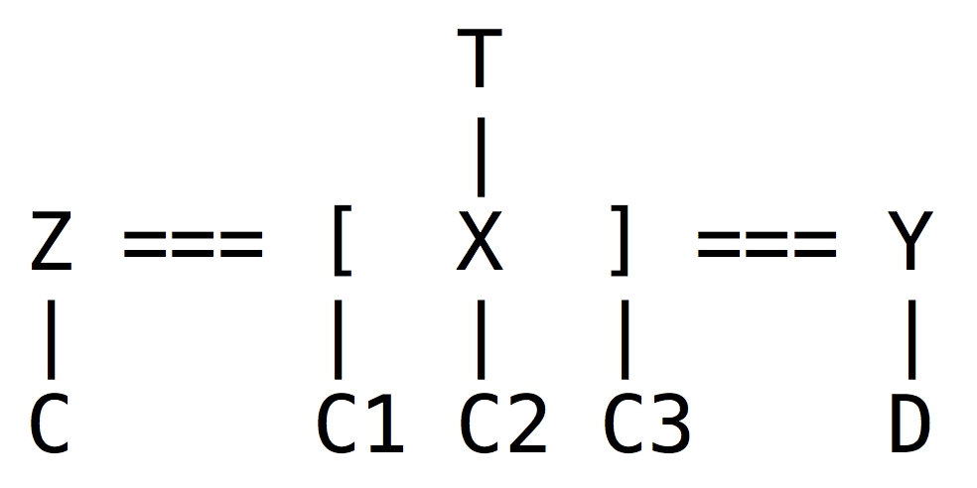

An Example
Z will tell X about C; C is a customer of Z, and X and Z are peers
X will tell Z and Y about C1, C2, and C3
Y will tell X about D
X will not tell Y about C; it makes no money to provide transit from Y to C
X doesn't tell Y about T; it would lose money to provide transit from Y to T
In example, Y appears disconnected from part of the network

Slide 12
An Example
BGP doesn't prevent this. In practice, it never happens. Because:
  Almost every AS is a customer of someone else (i.e., Y would buy transit from someone)
  Typically: small ASes buy Internet from Tier-3 ISPs, which buy Internet from Tier-2 ISPs, which buy Internet from Tier-1 ISPs. Tier-1's are huge; there are only a handful (10-15)
  Additionally, all Tier-1 ISPs peer with one another. So each Tier-1 ISP can provide global connectivity

Slide 13
BGP in Distributed Routing
HELLO protocol
  BGP sends KEEPALIVE messages to neighbors
Advertisements: Sent to neighbors
  BGP runs on top of TCP
  Doesn't have to do periodic advertisements to handle failure
Integration: via policies described above
Failures: routes can be explicitly withdrawn in BGP if fail
  Routing loops avoided because BGP is path-vector

Slide 14
Problems with BGP
Does it scale?
  Yes, it works on the Internet
  But, BGP routing tables are getting big
  Route instability due to misconfigurations or conflicting policies
  One region can buy Internet from more than one ISP -> bigger table
Is it simple?
  Yes to the protocol, but no to the implementation & operation
Is it secure?
  No. A region can advertise a fake vector

Slide 15
2017: BGP hijacking! Traffic for Google, Apple, Facebook, Microsoft and other tech giants routed through Russia
http://securityaffairs.co/wordpress/66838/hacking/bgp-hijacking-russia.html

Slide 16
Try It!
https://bgplay.massimocandela.com/

Slide 17
CASE: NAT
(Network Address Translation)

Slide 18
NAT (Network Address Translation)
Private network
  Public routers do not accept routes to network 10 (e.g., 10.8.8.8)
NAT router: bridge the private networks
  Router between private & public network
  Send: modify source address to temp public address
  Receive: modify back by looking mapping table
Limitations
  Some end-to-end protocols place address in payloads
  The translator may become the bottleneck
  What if two private network merge?

Slide 19
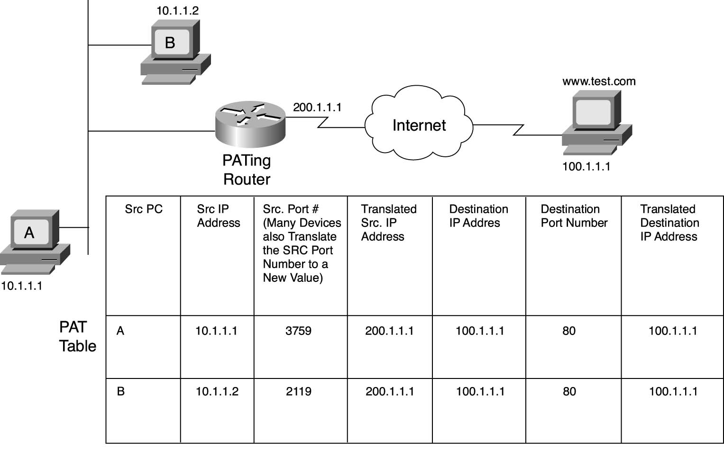
NAT

Slide 20
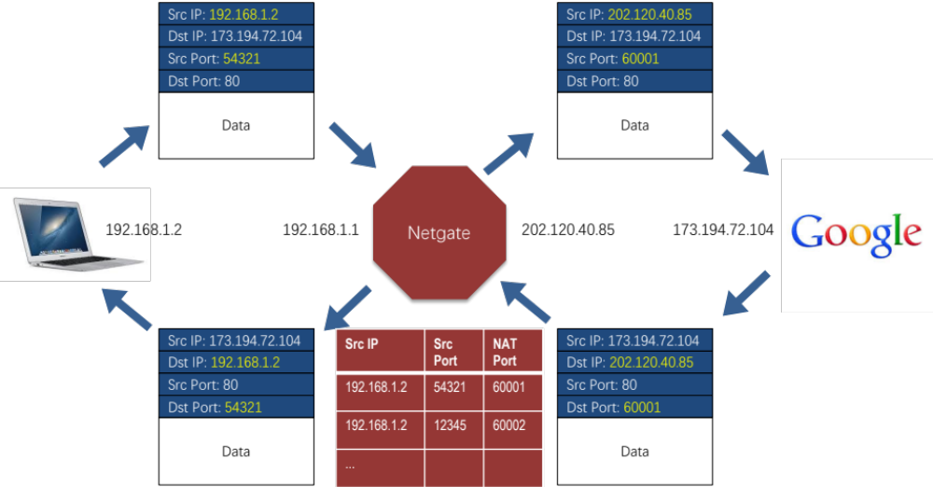
Gateway
* Note: TCP/IP Checksum recalculated -- one major factor of the performance costs

Slide 21
CASE: Ethernet Mapping
Mapping Internet to Ethernet

Slide 22
Case Study: Mapping Internet to Ethernet
Listen-before-sending rule, collision
Ethernet: CSMA/CD
  Carrier Sense Multiple Access with Collision Detection
Ethernet type
  Experimental Ethernet, 3 mpbs
  Standard Ethernet, 10 mbps
  Fast Ethernet, 100 mbps
  Gigabit Ethernet, 1000 mbps

Slide 23
Overview of Ethernet
A half duplex Ethernet
  The max propagation time is less than the 576 bit times, the shortest allowable packet
  So that two parties can detect a collision together
  If collision: wait random first time, exponential backoff if repeat
A full duplex & point-to-point Ethernet
  No collisions & the max length of the link is determined by the physical medium

Slide 24
Difference between Hub and Switch
Hub
  A frame is "broadcast" to every one of its ports
  A 10/100Mbps hub must share its bandwidth with each port
Switch
  Keeps a record of the MAC addresses of all the devices
  A 10/100Mbps switch will allocate a full 10/100Mbps to each of its ports

Slide 25
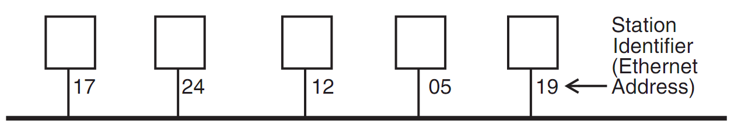
Broadcast Aspects of Ethernet
Broadcast network
  Every frame is delivered to every station
  (Compare with forwarding network)
ETHERNET_SEND
  Pass the call along to the link layer
ETHERNET_HANDLE
  Simple, can even be implemented in hardware

Slide 26
Broadcast Aspects of Ethernet
procedure ETHERNET_HANDLE (net_packet, length)
destination ← net_packet.target_id
if destination = my_station_id
then
GIVE_TO_END_LAYER (net_packet.data,
net_packet.end_protocol,
net_packet.source_id)
else
ignore packet
no need to do any forwarding

Slide 27
Broadcast Aspects of Ethernet
procedure ETHERNET_HANDLE (net_packet, length)
destination ← net_packet.target_id
if destination = my_station_id
or destination = BROADCAST_ID
then
GIVE_TO_END_LAYER (net_packet.data,
net_packet.end_protocol,
net_packet.source_id)
else
ignore packet

Slide 28
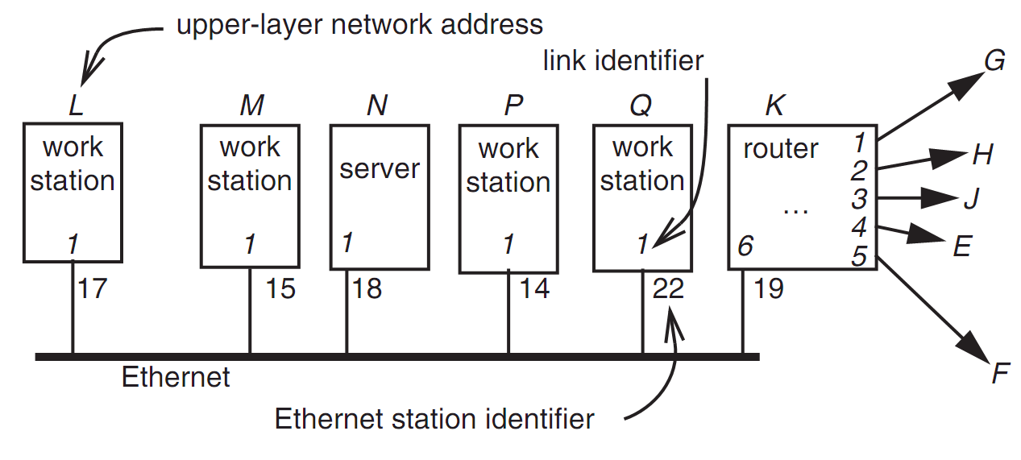
Layer Mapping: Attach Ethernet to Forwarding Network
15
L sends a RPC to N by sending to station 18 of link 1
L sends a RPC to E by sending to K, E may have 15 as address, as well as M

Slide 29
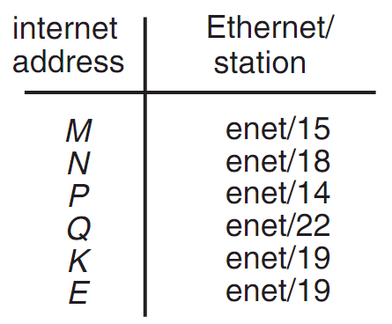
Layer Mapping
The Internet network layer
  NETWORK_SEND (data, length, RPC, INTERNET, N)
  NETWORK_SEND (data, length, RPC, ENET, 18)
L must maintain a table

Slide 30
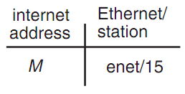
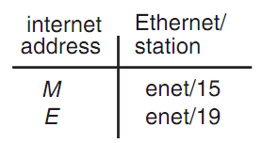
ARP (Address Resolution Protocol)
NETWORK_SEND ("where is M?", 11, ARP, ENET, BROADCAST)
NETWORK_SEND ("M is at station 15", 18, ARP, ENET, BROADCAST)
L asks E's Ethernet address, E does not hear the Ethernet broadcast, but the router at station 19 does, and it sends a suitable ARP response instead
Manage forwarding table as a cache

Slide 31
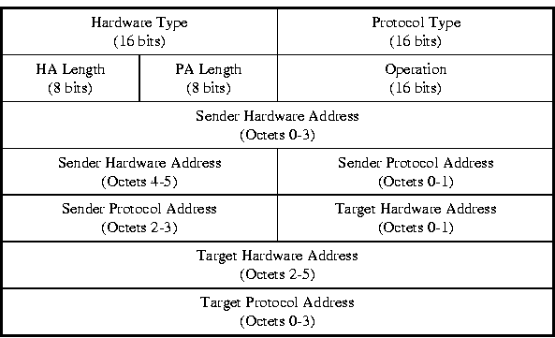
ARP & RARP Protocol
Name mapping: IP address <-> MAC address

Slide 32
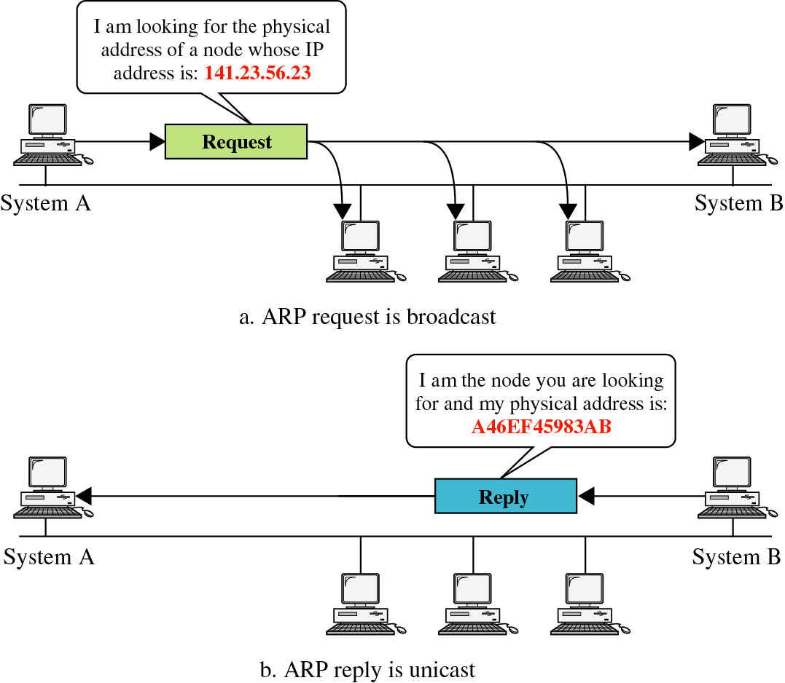
ARP &
RARP

Slide 33
Network Topology
Take SJTU network for example
  Subnet: usually like 192.168.0.2 or 10.0.0.2
  Gateway: usually like 192.168.0.1
    Get the global IP address: 202.120.40.82
    A gateway usually has two (or more) IP address
  Proxy: get proxy's address
    E.g., 106.185.46.164 (Japan)

Slide 34
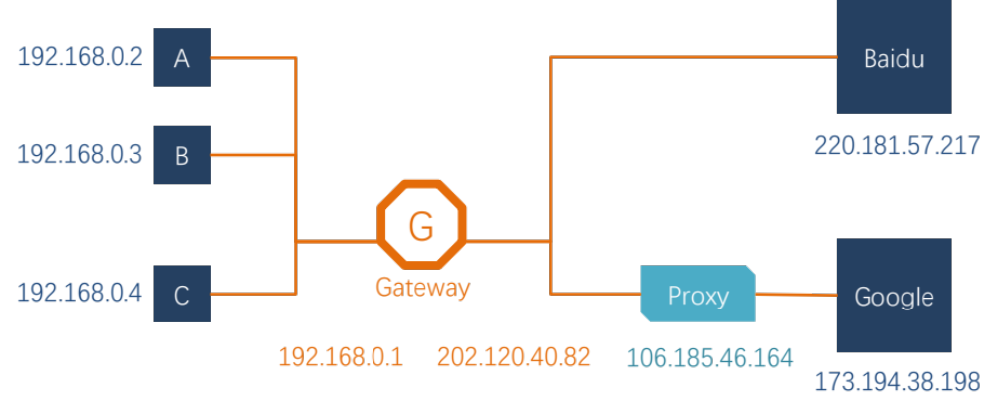
Network Topology

Slide 35
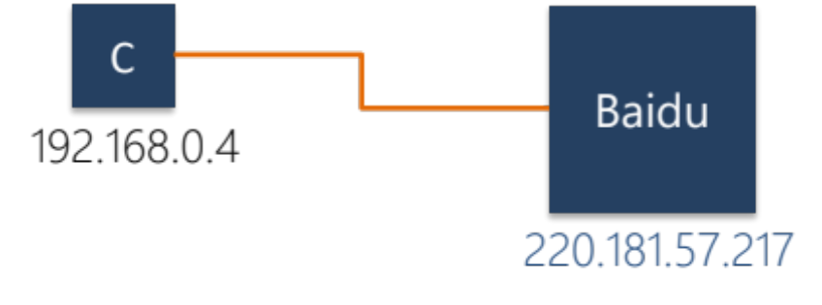
How to Use socket to Access www.baidu.com ?
You code as if your PC connect directly with Baidu
  Call connect() with Baidu's IP address
But how does the system find next hop?

Slide 36
Putting All Together
App: I want to send a packet to Baidu, here is the packet with Baidu's IP in its header as target IP, and client's IP as source IP (Node-C)
OS: I don't know how to get to Baidu, I'll just send it to the router (gateway). But I cannot change the source IP of the packet, so I'll just change the MAC target address of the packet to the router's MAC address

Slide 37
Putting All Together
The router-1 (gateway): I get a packet with my MAC as target address. Is it my IP? No… So I'll just forward it to next hop, by changing the target MAC address to next hop's MAC address (NAT: change source IP and source port as well)
Router-2: I connect directly to Baidu, I'll just change the target MAC address to Baidu

Slide 38
ARP Spoofing
Construct spoofed ARP replies
A target computer could be convinced to send frames destined for computer A to instead go to computer B
Computer A will have no idea that this redirection took place
This process of updating a target computer's ARP cache is referred to as "ARP poisoning"

Slide 39
Spoofed ARP reply
IP:10.0.0.2
MAC:cc:cc:cc:cc
Spoofed ARP reply
IP:10.0.0.2
MAC:cc:cc:cc:cc
switch
Spoofed ARP reply
IP:10.0.0.2
MAC:cc:cc:cc:cc
A
IP:10.0.0.1
MAC:aa:aa:aa:aa
B
IP:10.0.0.2
MAC:bb:bb:bb:bb
Hacker
IP:10.0.0.3
MAC:cc:cc:cc:cc
ARP cache
ARP cache
IP | MAC
10.0.0.2 | bb:bb:bb:bb
IP | MAC
10.0.0.1 | aa:aa:aa:aa

Slide 40
switch
A
IP:10.0.0.1
MAC:aa:aa:aa:aa
B
IP:10.0.0.2
MAC:bb:bb:bb:bb
Hacker
IP:10.0.0.3
MAC:cc:cc:cc:cc
A's cache is poisoned
ARP cache
ARP cache
IP | MAC
10.0.0.2 | cc:cc:cc:cc
IP | MAC
10.0.0.1 | aa:aa:aa:aa

Slide 41
ARP Spoofing
Now all the packets that A intends to send to B will go to the hacker's machine
Cache entry would expire, so it needs to be updated by sending the ARP reply again
  How often?
  depends on the particular system
  Usually every 40s should be sufficient
In addition the hacker may not want his Ethernet driver talk too much
  Accomplish with ifconfig -arp

Slide 42
Man-in-the-Middle Attack
A hacker inserts his computer between the communications path of two target computers
The hacker will forward frames between the two target computers so communications are not interrupted
E.g., Hunt, Ettercap, etc.
  Can be obtained easily in many web archives

Slide 43
Man-in-the-Middle Attack
The attack is performed as follows:
  Suppose X is the hacker's computer
  T1 and T2 are the targets
  X poisons the ARP cache of T1 and T2
  T1 associates T2's IP with X's MAC
  T2 associates T1's IP with X's MAC
  All of T1 and T2's traffic will then go to X first, instead of directly to each other

Slide 44
Spoofed ARP reply
IP:10.0.0.2
MAC:cc:cc:cc:cc
Spoofed ARP reply
IP:10.0.0.2
MAC:cc:cc:cc:cc
switch
Spoofed ARP reply
IP:10.0.0.2
MAC:cc:cc:cc:cc
T1
IP:10.0.0.1
MAC:aa:aa:aa:aa
T2
IP:10.0.0.2
MAC:bb:bb:bb:bb
Hacker
IP:10.0.0.3
MAC:cc:cc:cc:cc
ARP cache
ARP cache
IP | MAC
10.0.0.2 | bb:bb:bb:bb
IP | MAC
10.0.0.1 | aa:aa:aa:aa

Slide 45
switch
T1
IP:10.0.0.1
MAC:aa:aa:aa:aa
T2
IP:10.0.0.2
MAC:bb:bb:bb:bb
Hacker
IP:10.0.0.3
MAC:cc:cc:cc:cc
ARP cache
ARP cache
IP | MAC
10.0.0.2 | cc:cc:cc:cc
IP | MAC
10.0.0.1 | aa:aa:aa:aa
T1's cache is poisoned

Slide 46
Forged ARP replies
IP:10.0.0.1
MAC:cc:cc:cc:cc
switch
Forged ARP replies
IP:10.0.0.1
MAC:cc:cc:cc:cc
T1
IP:10.0.0.1
MAC:aa:aa:aa:aa
T2
IP:10.0.0.2
MAC:bb:bb:bb:bb
Hacker
IP:10.0.0.3
MAC:cc:cc:cc:cc
ARP cache
ARP cache
IP | MAC
10.0.0.2 | cc:cc:cc:cc
IP | MAC
10.0.0.1 | aa:aa:aa:aa

Slide 47
switch
T1
IP:10.0.0.1
MAC:aa:aa:aa:aa
T2
IP:10.0.0.2
MAC:bb:bb:bb:bb
Hacker
IP:10.0.0.3
MAC:cc:cc:cc:cc
ARP cache
ARP cache
IP | MAC
10.0.0.2 | cc:cc:cc:cc
IP | MAC
10.0.0.1 | cc:cc:cc:cc
T2's cache is poisoned

Slide 48
Message intended to send to T2
switch
Hacker will
relay the
message
T1
IP:10.0.0.1
MAC:aa:aa:aa:aa
T2
IP:10.0.0.2
MAC:bb:bb:bb:bb
Hacker
IP:10.0.0.3
MAC:cc:cc:cc:cc
ARP cache
ARP cache
IP | MAC
10.0.0.2 | cc:cc:cc:cc
IP | MAC
10.0.0.1 | cc:cc:cc:cc

Slide 49
Hacker will relay the message
switch
Message
intended to
send to T1
T1
IP:10.0.0.1
MAC:aa:aa:aa:aa
T2
IP:10.0.0.2
MAC:bb:bb:bb:bb
Hacker
IP:10.0.0.3
MAC:cc:cc:cc:cc
ARP cache
ARP cache
IP | MAC
10.0.0.2 | cc:cc:cc:cc
IP | MAC
10.0.0.1 | cc:cc:cc:cc

Slide 50
Defenses against ARP Spoofing
No Universal defense (!)
Use static ARP entries
  Cannot be updated; Spoofed ARP replies are ignored
  ARP table needs a static entry for each machine on the network
  Large overhead
    Deploying these tables; Keep the table up-to-date
Arpwatch
  A free UNIX program which listens for ARP replies on a network
  Build a table of IP/MAC associations and store it in a file
  When a MAC/IP pair changes (flip-flop), an email is sent to an administrator

Slide 51
Data Plane: Packet Forwarding

Slide 52
Network Layer Interface
structure packet
bit_string source
bit_string destination
bit_string end_protocol
bit_string payload

Slide 53
1 procedure NETWORK_SEND (segment_buffer, destination,
2 net_protocol, end_protocol)
3 packet instance outgoing_packet
4 outgoing_packet.payload ← segment_buffer
5 outgoing_packet.end_protocol ← end_protocol
6 outgoing_packet.source ← MY_NETWORK_ADDRESS
7 outgoing_packet.destination ← destination
8 NETWORK_HANDLE (outgoing_packet, net_protocol)
9 procedure NETWORK_HANDLE (net_packet, net_protocol)
10 packet instance net_packet
11 if net_packet.destination != MY_NETWORK_ADDRESS then
12 next_hop ← LOOKUP (net_packet.destination, forwarding_table)
13 LINK_SEND (net_packet, next_hop, link_protocol, net_protocol)
14 else
15 GIVE_TO_END_LAYER (net_packet.payload,
16 net_packet.end_protocol, net_packet.source)

Slide 54
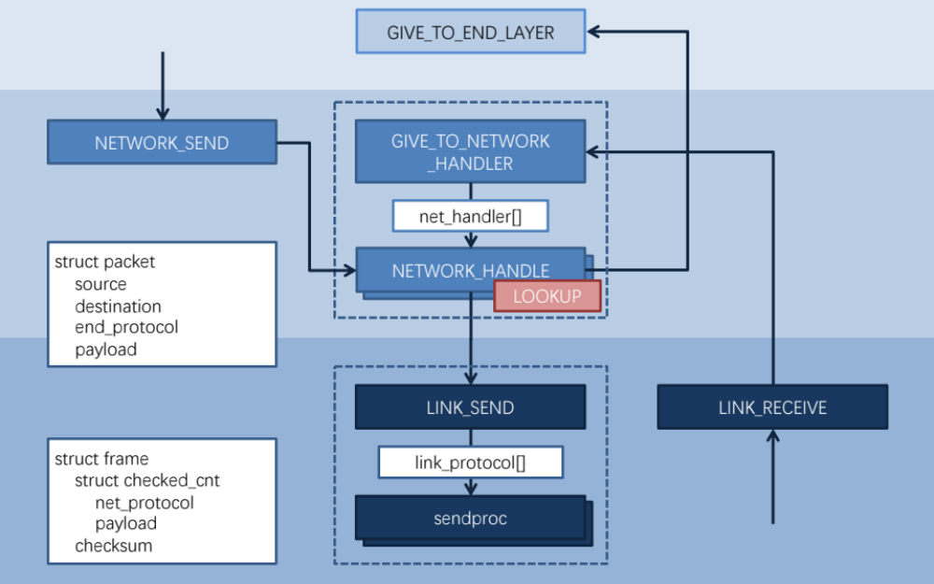

Slide 55
Forwarding an IP Packet
Lookup packet's destination in forwarding table
  If known, find the corresponding outgoing link
  If unknown, drop packet
Decrement TTL (Time To Live)
  Drop packet if TTL is zero
Update header checksum
Forward packet to outgoing port
Transmit packet onto link

Slide 56
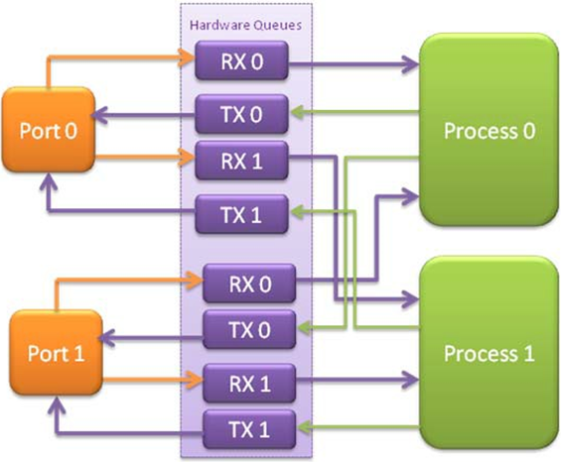
Data-plane Case Study: Intel's DPDK
DPDK: Data Plane Development Kit
  Bypass kernel
Network card
  Has several ports
  A port has RX/TX
Processor
  Read packets from RX
    Polling
  Find output port
  Write packets to TX
RX for receiving
TX for sending

Slide 57
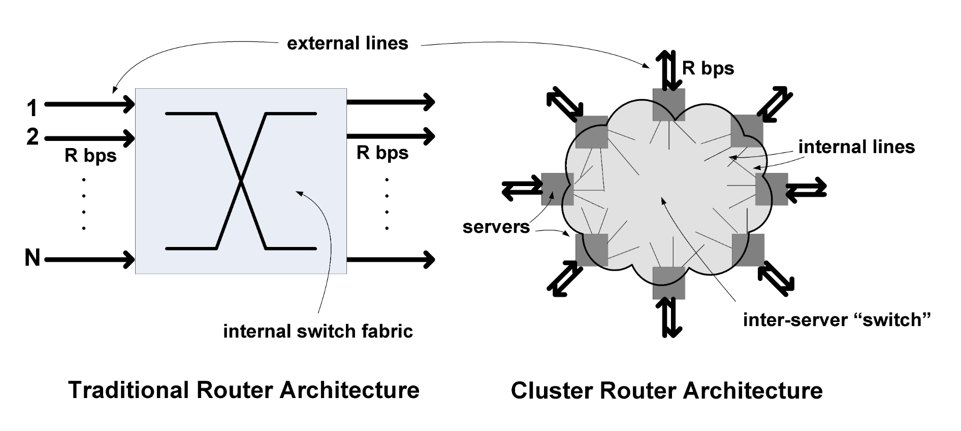
UC Berkeley’s RouteBricks [SOSP’09]

